Slide 1
Equity in Open
Humanities
Dr Alice Gibson, Jisc

Slide 2
Padlet
https://padlet.com/alicegibson1/equity-in-open-humanities-6xb6zk3grd65zto1

Slide 3
Personal decisions
Seek community led initiatives- journal run on university webpages
Challenge: potentially the longevity of records.
Solution: self archive on repository (e.g. Humanities Commons), or several
Seek university affiliation via other means- visiting fellowships
Be purposeful in choosing publishing where to publish – do they align with my values/do they have OA policies that align with current funders’ policies (ensures access to my work is consistent with those of funded peers) – Using the community-maintained chapter spreadsheet as a reference point
Checked if I can make use of transitional agreements, focusing on always having a backdrop of green OA (advocating for Rights Retention Strategy)

Slide 4
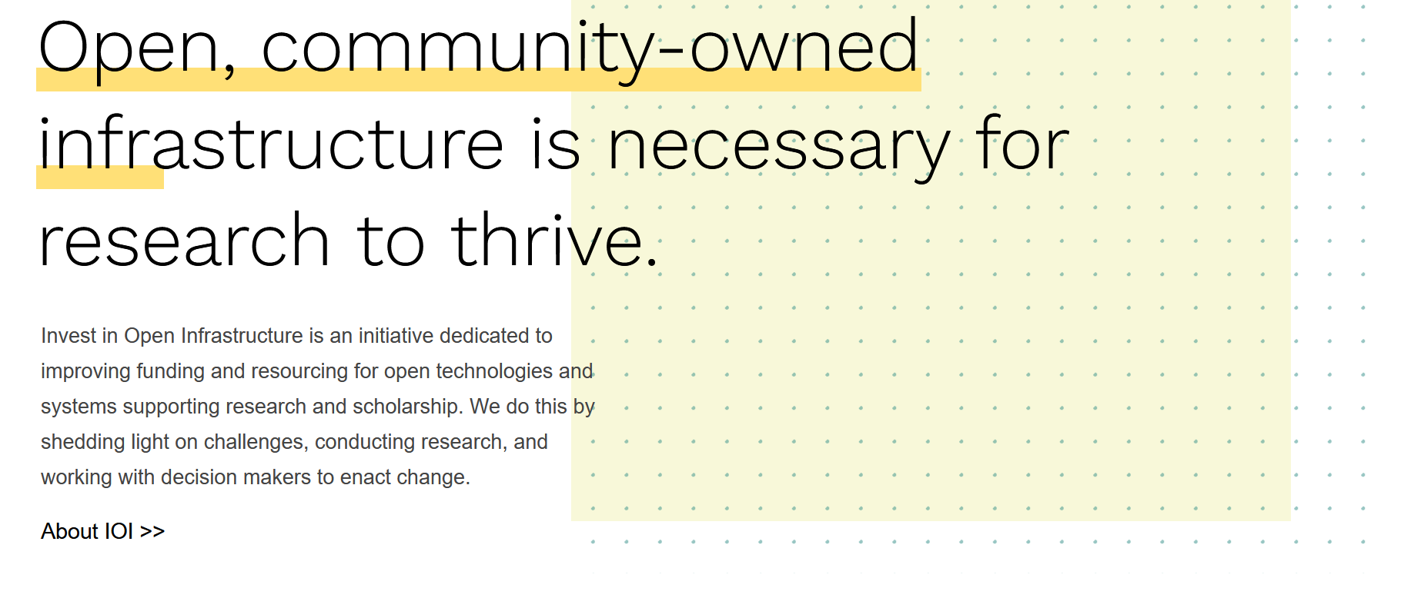
Decisions working in an institution
Seek to support community led initiatives – Jisc’s ‘S20’/Subscribe to Open scheme, and signing up to Transformative Agreements
Try to direct funds to where they are most likely to be used well in the long term to ensure diverse landscape, such as Invest in Open Infrastructure (IOI)
Signup to transitional agreements – this opens up publishing opportunities to researchers less likely to have personal funding:
https://library.northumbria.ac.uk/open-access/publisher-agreements

Slide 5
questions
What experiences have you had publishing with colleagues not affiliated with an institution? Are there any solutions you have identified in doing so?
Have you benefited from agreements your university has signed up to that you wouldn’t have been able to make your work gold open access in before? How else can HEIs support those who can’t pay?
More generally;
What specific kind of support do you feel you would benefit from to ease the process of making work open access?
Do you use the Rights Retention Strategy? What are your thoughts on this? How has your experience been, if so?
https://padlet.com/alicegibson1/equity-in-open-humanities-6xb6zk3grd65zto1

